Slide 1
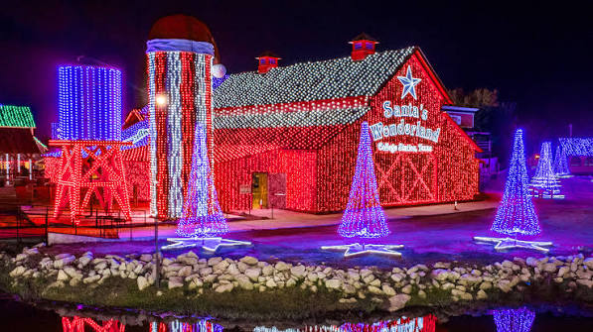

Santa’s Wonderland
DISCOVERY PROPOSAL – JULY 2026

Slide 2



Project Background
Modernizing Ticketing Platform and Creating Unified Guest Experience
Santa’s Wonderland Leadership would like to modernize their legacy Ticketing platform, add Guest Loyalty features, unify Guest data, Operations, Reporting and Analytics, Employee portal to provide an enhanced Guest Experience and efficient Executive Management.
The current fragmented systems limit growth and Executives would like to move from vendor-constrained systems to a custom, owned platform that enables loyalty, analytics, and long-term scalability and flexibility.
The following proposal outlines the activities, deliverables, cost, and timeline for Improving’s Discovery assessment and implementation framework.
What Differentiates Improving?
Domain Expertise
Improving is trusted by the largest companies in the world to capture improvements using AI and align client teams with best practices.
Tech Stack Subject Matter Expertise
Our teams bring deep experience across ticketing, loyalty, and guest-data platforms, and we know where AI adoption creates real ROI versus where it adds risk.
Strategic Partnerships
We’ll leverage our strategic partnerships (where applicable) to help fund innovation.
Trust and Culture
We establish trust by training and certifying our clients so that we can hand off to internal teams and save money. 9 out of 10 Improving clients refer us to others in the company.

Slide 3
The Vision: One Brand, Every Day of the Year
Delight Shouldn’t Have a Season
Santa’s Wonderland has built something rare every December: an experience that creates genuine delight. The platform vision carries that same feeling of delight and recognition across every month of the year, not just the holiday season.
Ticketing, the mobile app, on-site operations, guest service, and marketing all draw from one guest identity. A family that visits over the holidays and returns for a spring event should feel like the same brand remembers them, not like they’re introducing themselves to a stranger.
That consistency is what turns a seasonal attraction into a brand guests live inside all year long and for years to come.
What the Unified Platform Makes Possible
Consistent Experience, Every Channel
Ticketing, app, on-site operations, and guest service all speak from the same guest profile, so the experience feels seamless whether a guest is buying tickets in July or walking through the gates in December.
Loyalty That Compounds, Year After Year
A unified guest record lets Santa’s Wonderland recognize returning guests and reward tenure, turning a one-time visitor into a multi-year relationship instead of restarting from zero every season.
Reasons to Stay Engaged Between Visits
Off-season previews, membership perks, and personalized offers give guests a reason to stay connected to the brand year-round, not just during the holiday rush.

Slide 4
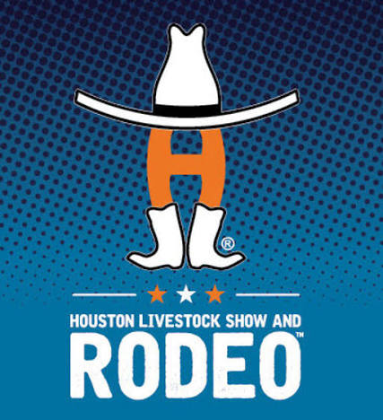
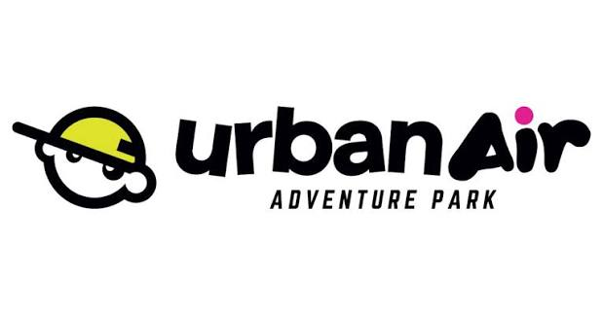
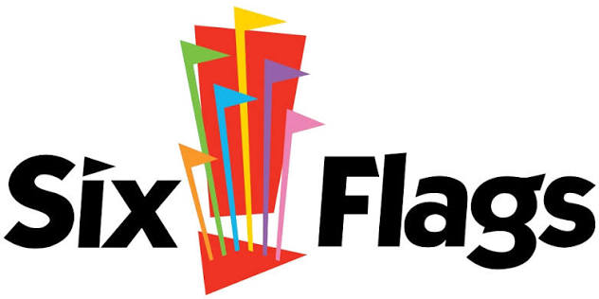
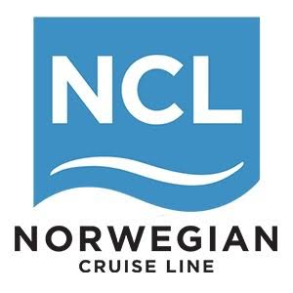
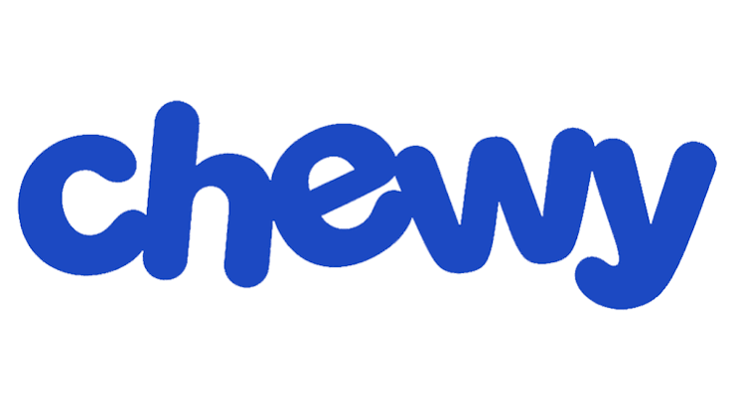
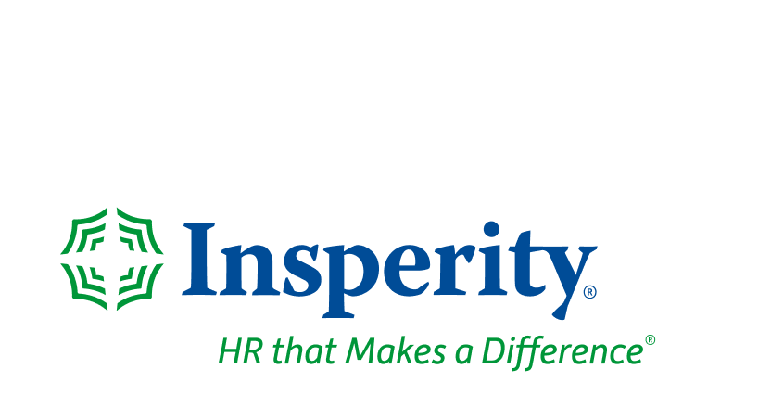
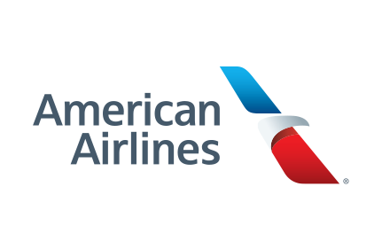
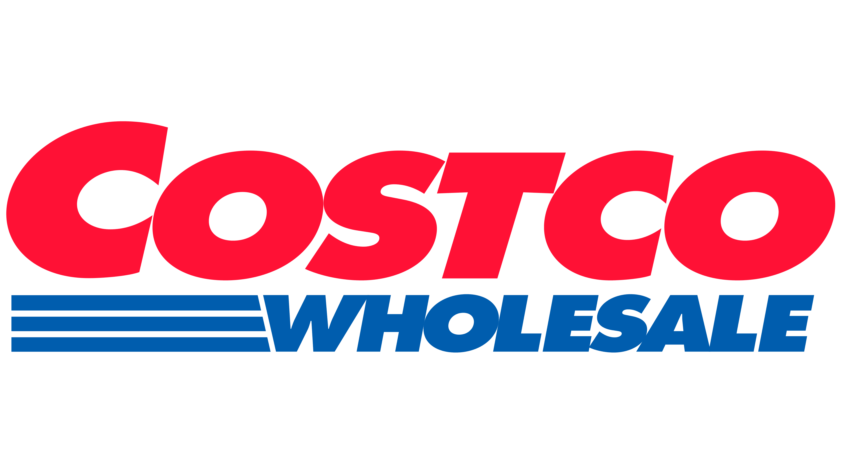
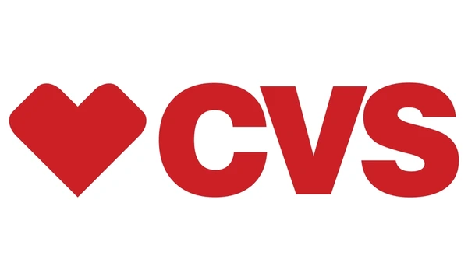

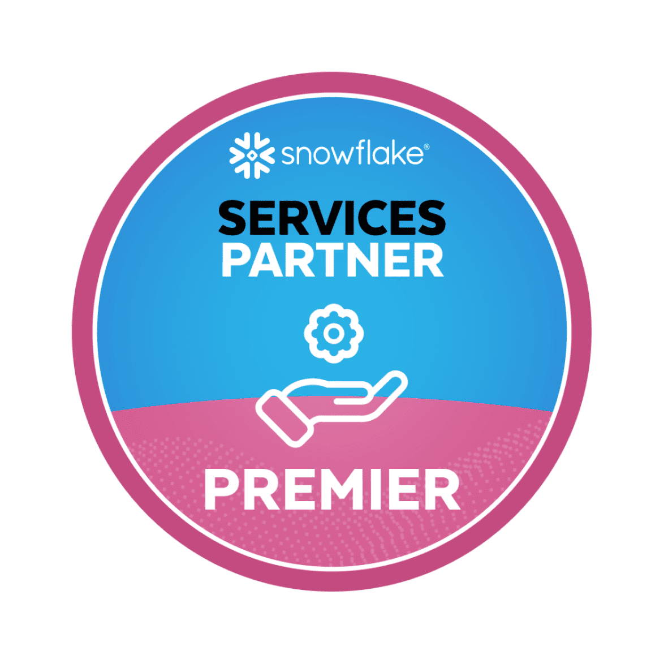
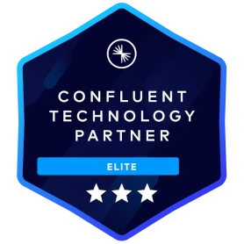

Brands, Partners, and Certifications
LEADING BRANDS
PARTNERSHIPS
CERTIFICATIONS

Slide 5
Recommended Approach

Slide 6
Discovery & Assessment: What It Delivers
A 6-week engagement to map the full platform vision
Activities
Review current-state systems: ticketing platform, HubSpot CRM, Zendesk, Square, and the LMS/payroll tools in scope
Stakeholder workshops with Leadership and Operations to map the full guest and employee experience
Map the complete platform vision: ticketing, loyalty, guest data, employee portal, LMS, payroll, mobile ordering
Deliverables
A recommended technology architecture and cloud strategy
A phased platform roadmap so Phase 1 doesn't box in what comes next
A detailed cost, timeline, and acceptance-criteria estimate for Phase 1 (Ticketing + Loyalty)

Slide 7
Platform & Delivery Recommendations
Where we already have conviction and one decision that's yours to make
Recommendations (subject to findings):
Cloud: Azure; given current licensing
Payments: Keep Square. Never own payment-processing risk in-house
Accounting: Leverage Square and the ticketing tool; the new platform is additive
Ongoing Ownership Decision
OPTION A
Improving-Managed (Retainer)
Improving retains ongoing maintenance and support on a flexible retainer that scales up for the season and down in the off-months; how we support other client's seasonal model. No in-house hire needed.
OPTION B
In-House Hire, Improving-Trained
Improving builds the platform and trains a client-hired technical resource during the build so they're ready to own maintenance at handoff. Improving stays available for larger future builds.
OPTION C
Lightweight Retainer (Future State)
A lower-touch, ticket-based retainer becomes viable once the platform stabilizes; realistically a couple of years out, not a Day-1 choice.

Slide 8
Discovery Engagement: Process & Investment
Discovery to Phase 1 plan
1
2
3
4
5
Kickoff & Current-State Review
Week 1
Stakeholder Workshops
Weeks 1–2
Full-Platform Vision Mapping
Weeks 2–4
Architecture & Cloud Strategy
Weeks 4–5
Phase 1 Estimate & Readout
Week 6
6 WEEKS, START TO FINISH
INVESTMENT: [ to be finalized ]

